Slide 1
MINING NETFLOW RECORDS FOR HOST BEHAVIORS
Teja Kommineni
Robert Ricci, Kobus van der Merwe and Suresh Venkatasubramanian

Slide 2
Thesis Statement
By combining clustering and other data mining techniques we can produce a view of host behaviors that helps network administrators
to understand behavior of the networks.
This system complements existing network analysis tools to ease network management.
Notes:
Read it and pause for a moment.

Slide 3
Thesis Statement Explained
Hosts
Behaviors (Packets, Bytes, Destinations, Protocols over a time period)
Network Management
Data Mining
Notes:
2) Behavior of a host is an aggregate of the amount of traffic that it sends both in terms of packets and
bytes, the set of destinations it tries to connect to , the set of protocols it uses over some time period.
So we want to find these host behaviors to ease network management.
3) Security, Capacity Planning, Congestion Handling, Quality Of Service, Threat Analysis, IDS, Traffic Classification.
4) There is lot of data to look into.. DM instead of ML is .. you want to find behaviors/patterns a human may have not known to look in first place.
Overall we want to find the behaviors of hosts group those behaving similarly so that they help in

Slide 4
Techniques used by admins
Aggregation by Ports, Protocols, Applications [SolarWinds]
Deep Packet Inspection
Rule Based Systems (IDS)
Notes:
1) In order to know the top used applications, who are contributing to major traffic, to understand the bandwidth requirements and to address congestion.
2) Inspects the actual payload of the packet. It is a fine grain version of above point. What are the sites or urls.
3) Limiting the number of attempts to login into a system, placing rules on how many requests a host can make in given time to avoid DDOS attacks.
We have built a tool that complements these existing techniques. Let us look into it in detail.

Slide 5
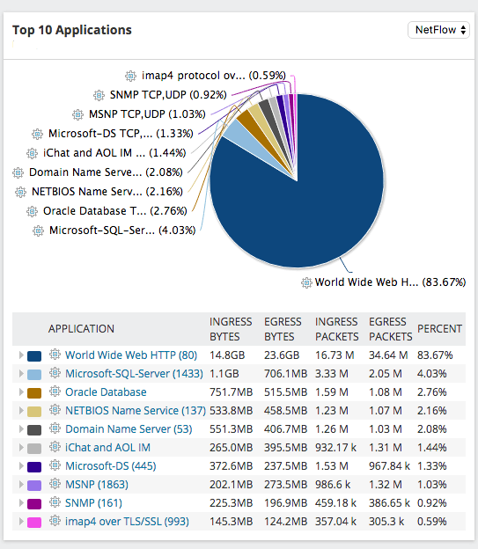
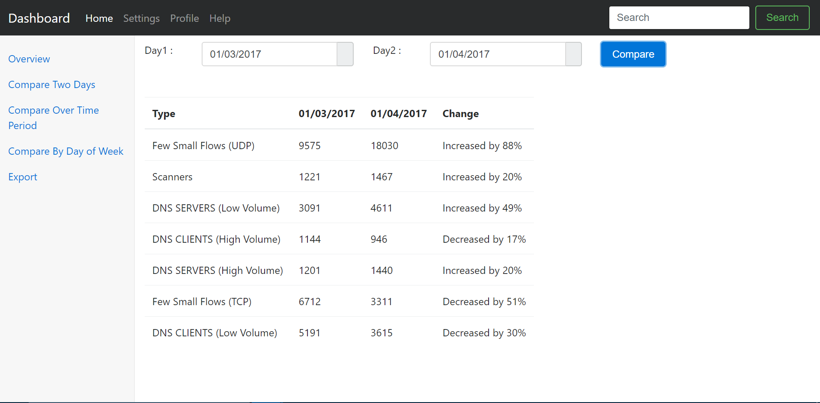
Complementary Tool
Solar Winds
Our Tool
Notes:
How are these two similar? - They both use same data.
How are they different? – They are 2 different views of same data , while one aggregates based on ports other does it based on host behaviors. We induce domain knowledge to label these behaviors.
Why do we need a different tool? , similar ports for different services, thus making it tough to distinguish based on just a single feature.
Are we the first guys using ML, DM on network data.
However, they are often observed to fail, either because of packet encryption, arbitrary or dynamic port use, or because different protocols or utilizations employ the same single port.

Slide 6
Related Work
Supervised vs Unsupervised Learning
Machine Learning for Traffic Classification [Andrew and Denis], [2012] [ACM]
Unsupervised approach for Traffic Classification [Jeffrey and Mahanti] [ACM] [2011]
Notes:
Using this supervised technique mentioned now, people tried to classify network traffic into known classes.
Till now we have seen techniques used by the admins, the tool we ought to build and related work in this area. Now let us see how did we approach this problem. Just to reiterate the problem that we want to solve here is to determine the host behaviors and group those behaving similarly. We have built a system to solve this. In the next slide we will see the design of this system one component at a time.

Slide 7
Design
GUI
Feature Engineering
Pattern Detector
Anomaly Detectors
Host-Based Split
Capacity
Planning
export
Routers
Tools used
Implemented
export
Applications
NetFlow Collector
Notes:
This is the structure for rest of my talk.

Slide 8
NetFlow Collector
Feature Engineering
GUI
Pattern Detector
Anomaly Detectors
Host-Based Split
Routers
Capacity
Planning
NetFlow Collector
Tools used
Implemented
Applications
Input Data (Flows)
What is NetFlow?
Why NetFlow Collector?
Notes:
Since, collecting all the packets is tough and infeasible
All packets with the same source/destination IP address, source/destination ports, protocol interface are grouped into a flow. In short flow is an instance of communication between two hosts.

Slide 9
Feature Engineering
Feature Engineering
GUI
Pattern Detector
Anomaly Detectors
Host-Based Split
Routers
Capacity
Planning
NetFlow Collector
Tools used
Implemented
Applications
Notes:
The raw data that we obtained in previous step cannot be used directly in ML. We need to clean this data and select those columns that better represent the problem we ought to solve. These selected columns are called features and this process of cleaning and selecting features is called Feature Engineering. Even simpler ML algos work well if we select good features.

Slide 10
Missing Data
Feature Engineering
GUI
Pattern Detector
Anomaly Detectors
Host-Based Split
Routers
Capacity
Planning
NetFlow Collector
Tools used
Implemented
Applications

Slide 11
Feature Engineering
GUI
Categorical Data
Pattern Detector
Anomaly Detectors
Host-Based Split
Routers
Capacity
Planning
NetFlow Collector
Tools used
Implemented
Applications

Slide 12
GUI
Host Based Split
Feature Engineering
Pattern Detector
Anomaly Detectors
Host-Based Split
Routers
Capacity
Planning
NetFlow Collector
Tools used
Implemented
Applications
Feature Scaling
Notes:
Till now we cleaned the raw data to make it useful, now we want to model a host behavior using this data. In order to achieve that we aggregated the following values for each host, explain them and each column is called feature and each row/ record defines the behavior of that particular host for a given day.
One aspect of this data that I have to mention here is the skewness of the data as shown in next page.

Slide 13
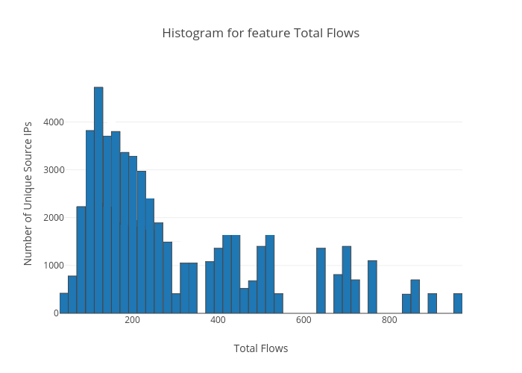
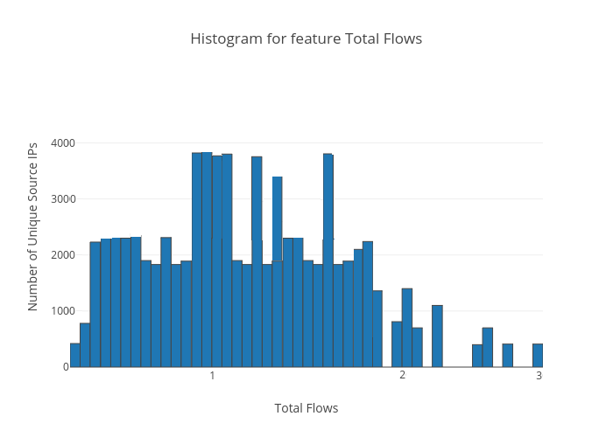
Normalization
Feature Engineering
GUI
Pattern Detector
Anomaly Detectors
Host-Based Split
Capacity
Planning
NetFlow Collector
Tools used
Implemented
Applications
Notes:
Each feature is highly skewed towards the left and the reason for this is most hosts.
By the end of this step we have modeled host behaviors using the NetFlow data and are set to group all the hosts that behave similarly.

Slide 14
GUI
Pattern Detector
Feature Engineering
Pattern Detector
Anomaly Detectors
Host-Based Split
Capacity
Planning
NetFlow Collector
Tools used
Implemented
Applications
Why Unsupervised Learning?
Why Clustering ?
Why K-Means ?
Over-Fitting
Scalable
Notes:
1) By now, one might have clearly seen that our data doesn’t have any labels. So, as we talked in the related section this falls under Unsupervised Learning. Also, we want to group all those hosts that behave similarly. Clustering is the task that groups objects that are similar to each other.
2) We have chosen K-Means clustering to solve this problem and our reason is 3-fold. Over-fitting, Scalable, our practical exp with other algos. Let us see what K-Means algorithms is all about.

Slide 15

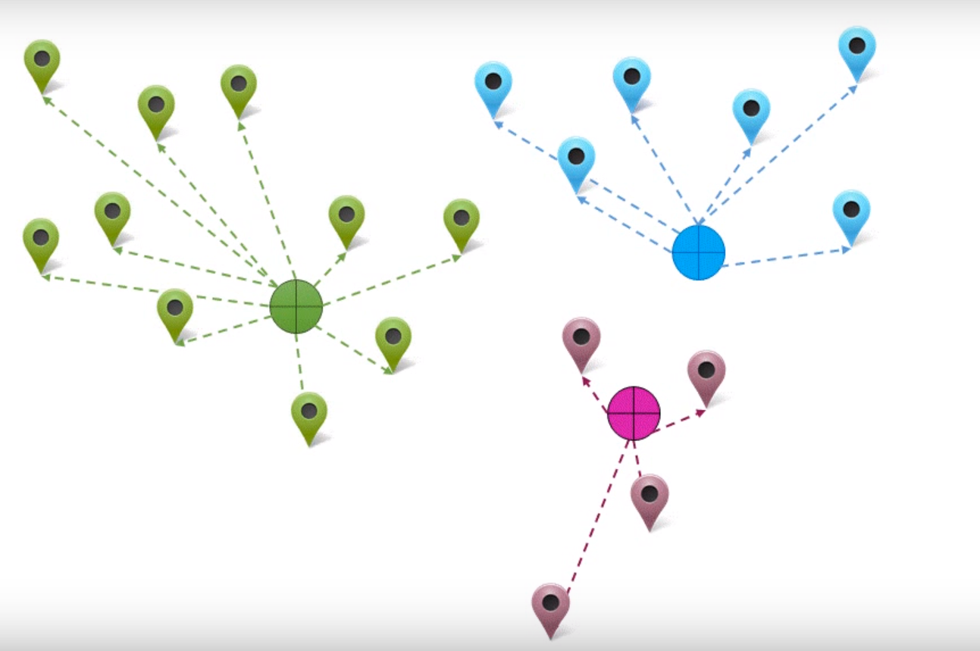
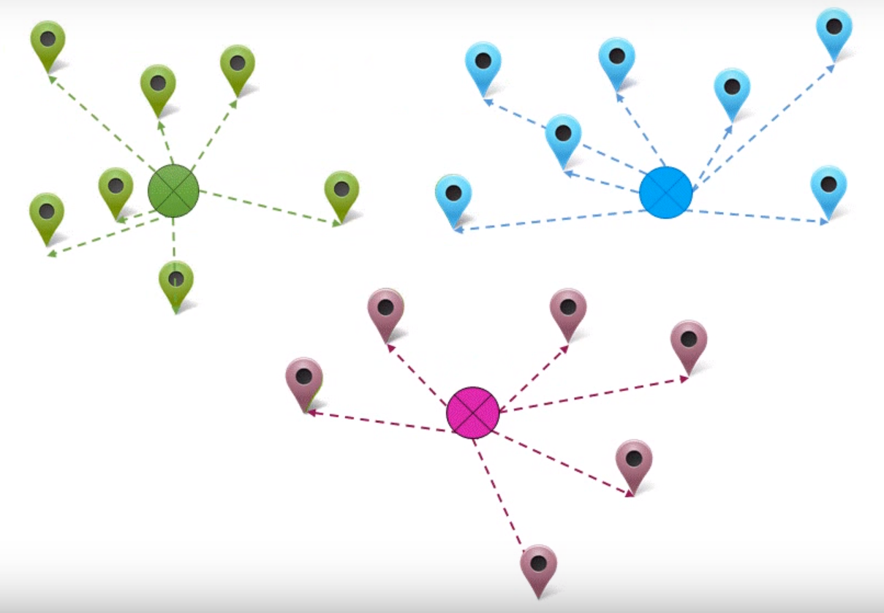
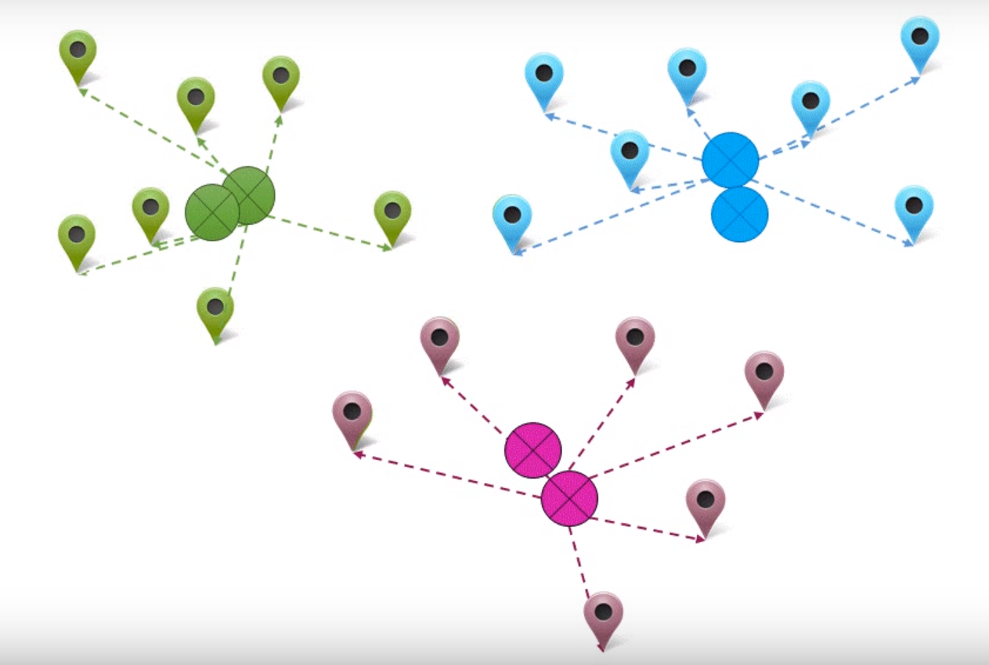
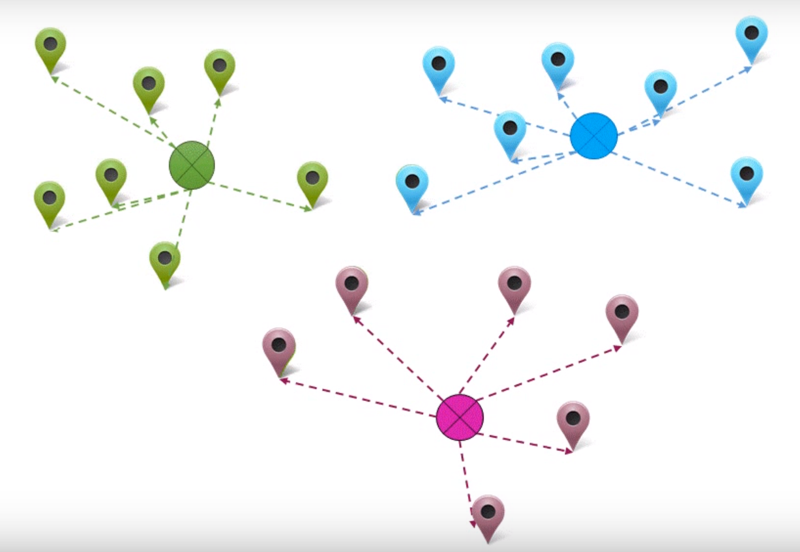
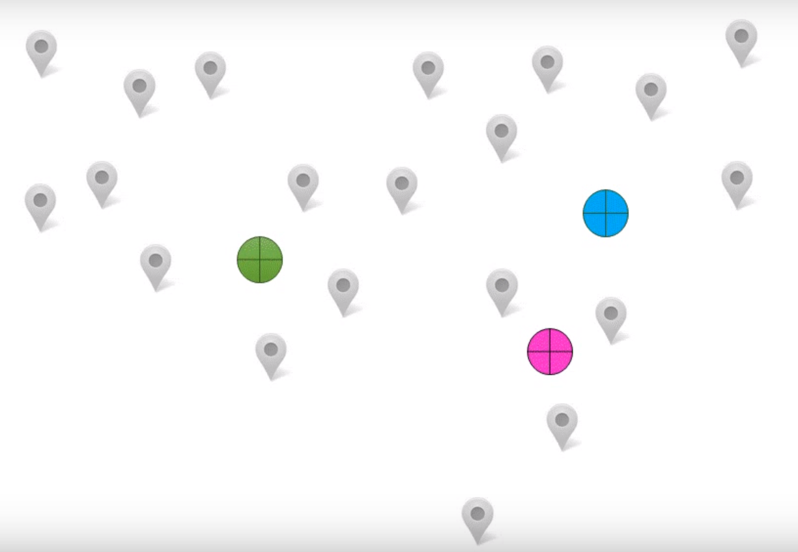
K-Means
Feature Engineering
GUI
Pattern Detector
Anomaly Detectors
Host-Based Split
Capacity
Planning
NetFlow Collector
Tools used
Implemented
Applications

Slide 16
GUI
How to choose K ?
Feature Engineering
Pattern Detector
Anomaly Detectors
Host-Based Split
Capacity
Planning
NetFlow Collector
Tools used
Implemented
Applications
Elbow Method
Silhouette
Notes:
We need to specify initial K value. We can’t choose a random K value as higher value can give us repetitive behaviors and small K value doesn’t give any useful info.
Also each network data has different k value and hence we need a method for K. In our case we found the K value as 7. So, we have found seven unique behaviors hosts are exhibiting in our system. Now, let us see what we have done till now in form of a process diagram.

Slide 17
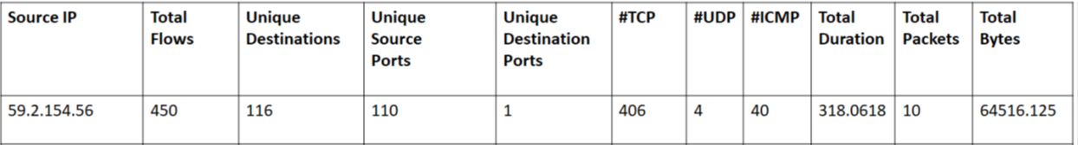
Process Diagram..
Reference Day
Interactive Traffic 1
K – Means (K = 7)
Interactive Traffic 2
Clients 1
Clients 2
Servers 1
Servers 2
Scanners
Notes:
What are these ? These are data points and each data point corresponds to a host and its behavior.
So to automate this process we chose a reference day and manually labeled the clusters

Slide 18
Process Diagram..
Reference Day
Interactive Traffic 1
K – Means (K = 7)
Interactive Traffic 2
Clients 1
Clients 2
Servers 1
Servers 2
Scanners
Notes:
What are these ? These are data points and each data point corresponds to a host and its behavior.
There are two points that I want to mention here. 1) This one to one mapping works because the number of behaviors that our hosts are exhibiting is constant over time. 2) If network administrator observes there is a change in the way the network is being used. He can chose a new reference day that captures these changes perform our process and label the clusters and use this new reference day going forward.

Slide 19
Results
Cluster Label | Cluster Definition
T1 | One-one connections, http/https, ssh and peer to peer traffic (long living flows with large average packet sizes)
T2 | large number of flows which are short-lived and an average packet size less than T1
C1 | clients making connections with different servers. Hosts with request for web pages and outbound mail traffic.
C2 | dominated by DNS traffic which is in accordance with the heavy DNS requests that the hosts residing in the emulab network make.
S1 | majority of hosts which are within emulab network and are acting as servers accepting SSH requests.
S2 | hosts that are both within and outside emulab network which are acting as servers for different sets of traffic such as SSH, Web and DNS.
A1 | hosts that exhibit anomalous behavior trying to scan different access points to enter into the system.

Slide 20
Data set
Data Source | Emulab Routers
Time Period | Eight Months
Average number of Flows per day | 40 Million
Average number of Hosts per day | 30000

Slide 21
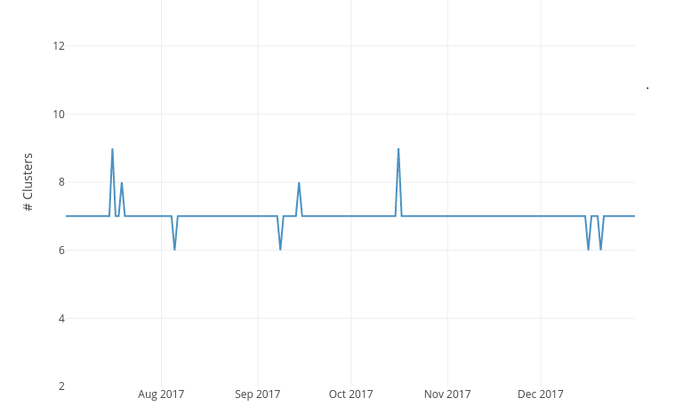
Process Diagram..

Slide 22
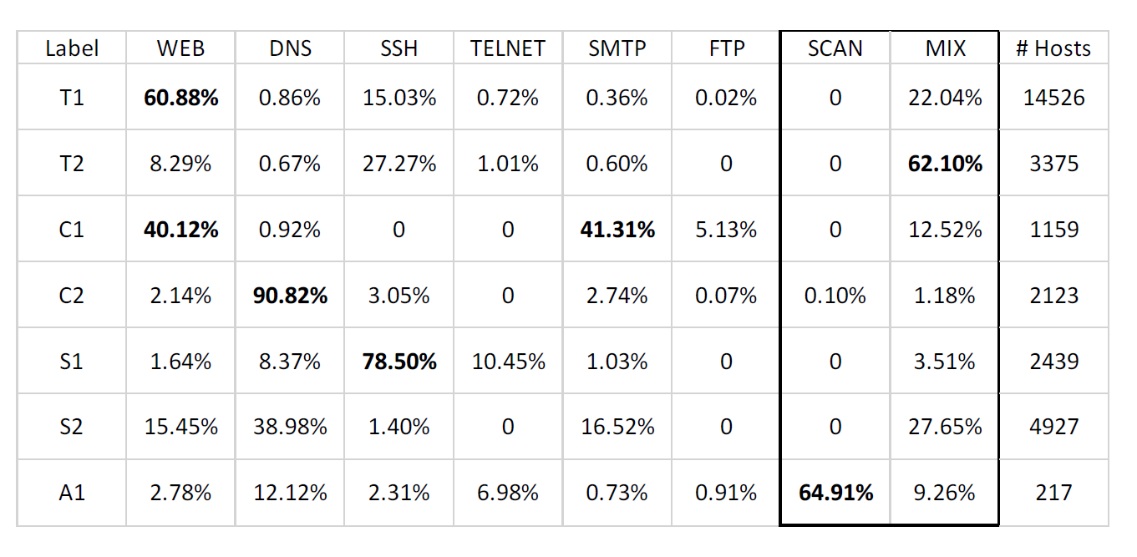
Cross-Validation

Slide 23
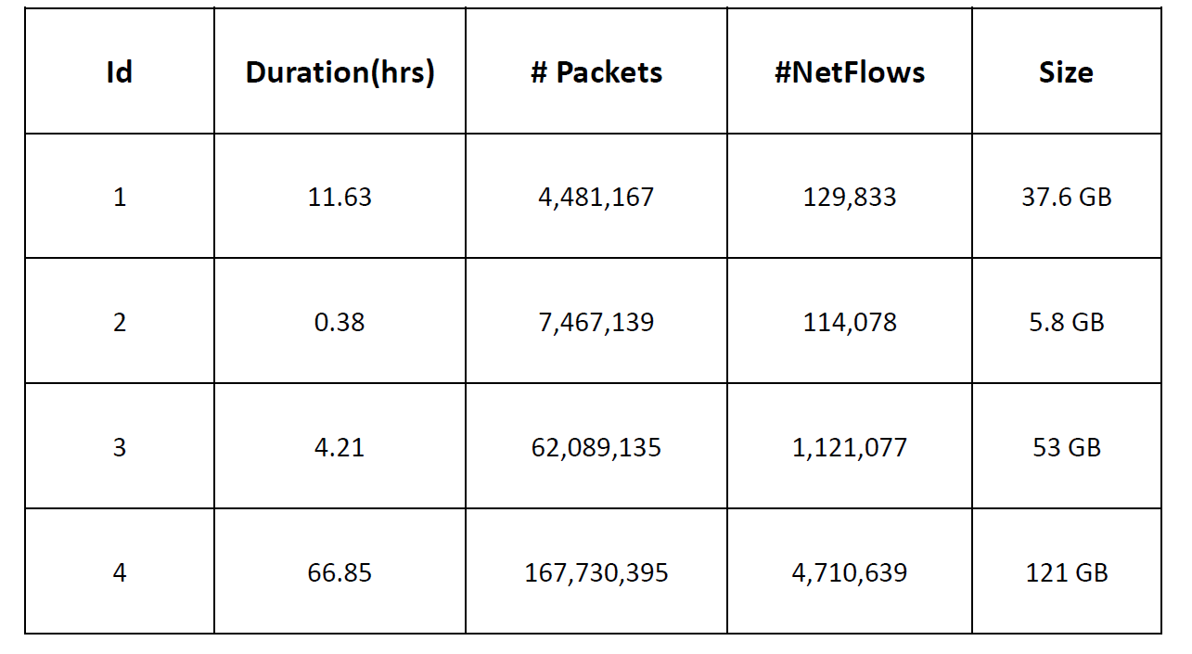
Labeled Data
Center for Applied Internet Data Analysis
Notes:
CAIDAs dataset consists of thirteen different scenarios. Each scenario is a capture of
network data written into a pcap file. Each capture consists of both real network traffic
and the synthetic traffic they have generated to emulate that scenario.

Slide 24
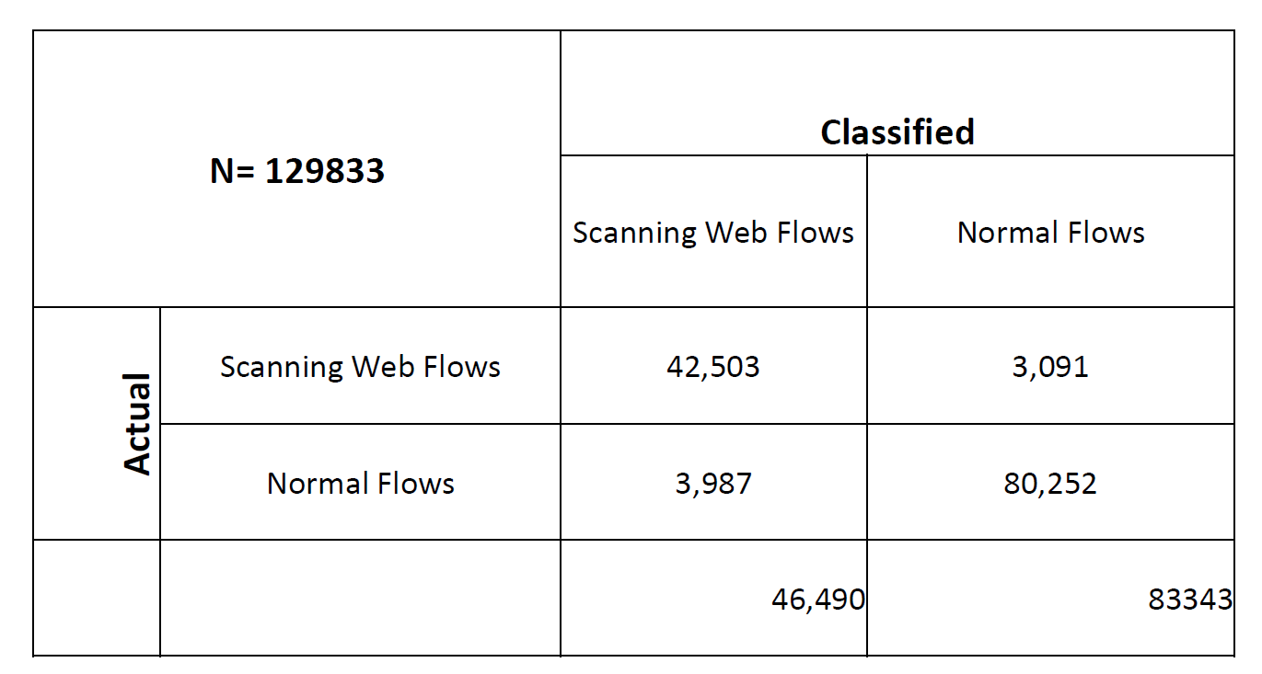
Results
91.4% accurate in finding scanners.
96.2% accurate in finding normal hosts.

Slide 25
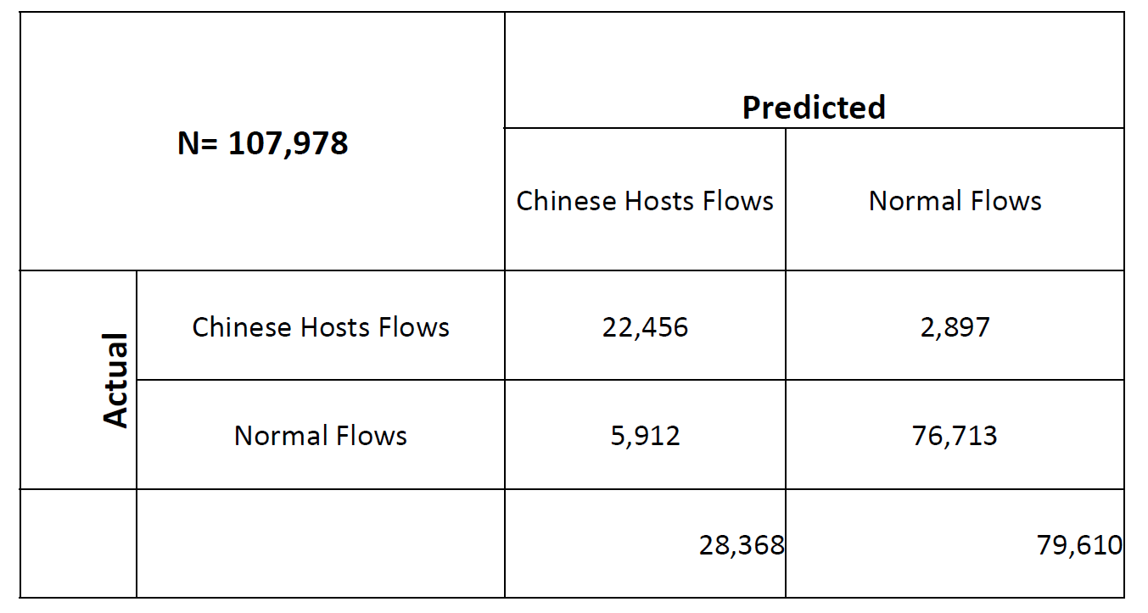
Results
76.1% accurate in finding Chinese hosts.
96.3% accurate in finding normal hosts.

Slide 26
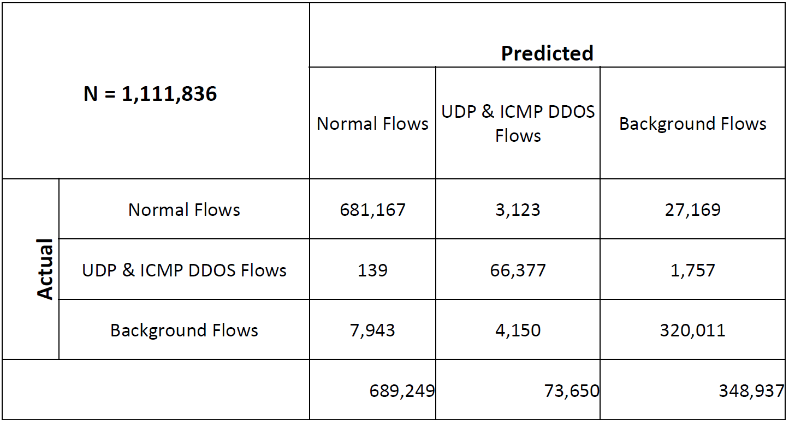
Results
91.1% accurate in finding background hosts.
98.8% accurate in finding normal hosts.
90.23% accurate in finding UDP & ICMP DDOS hosts.

Slide 27
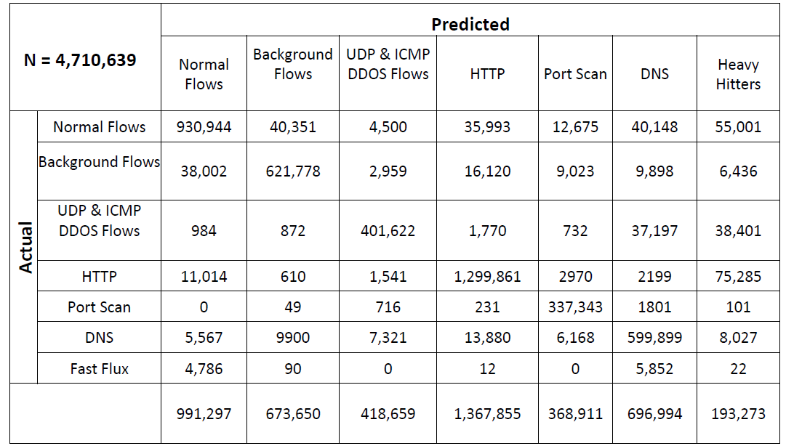
Results

Slide 28
Results

Slide 29
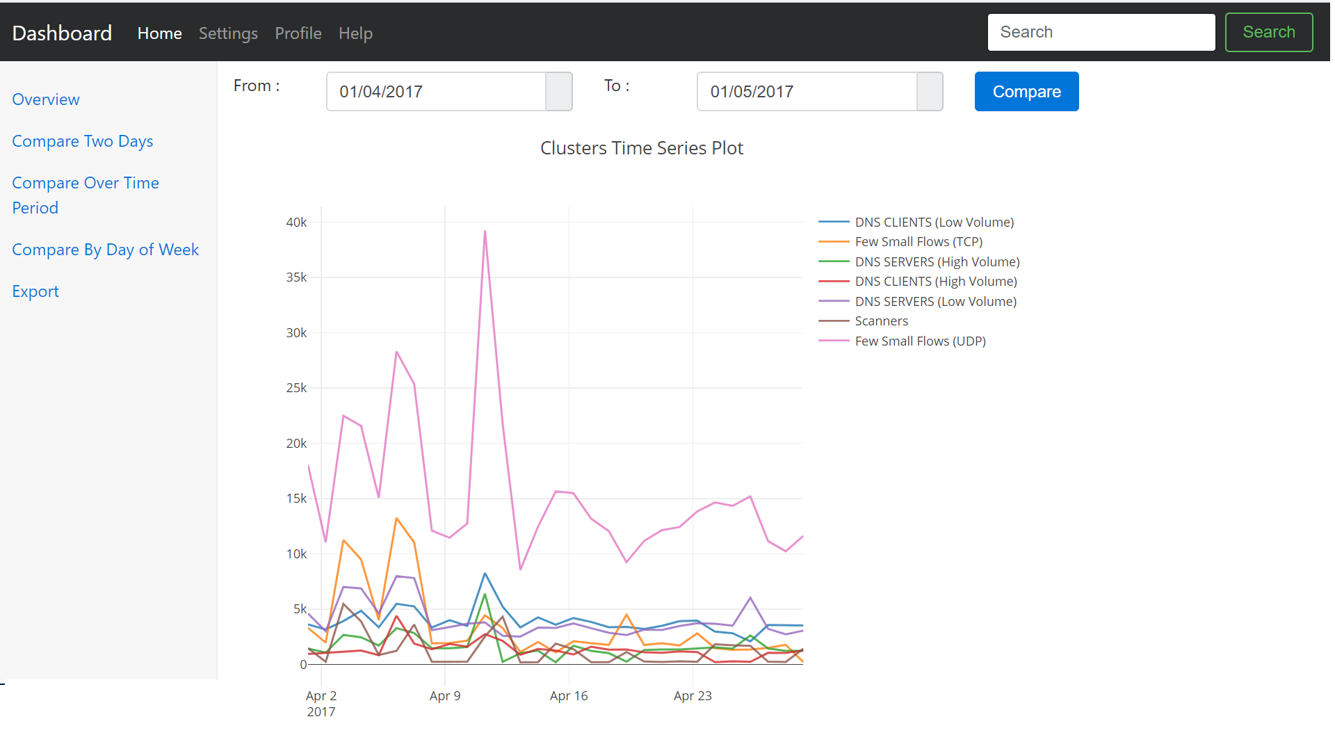
Results

Slide 30
Future Work
Applications
Temporal Clustering
Unique IP address
Streaming Algorithms

Slide 31
Questions
“By combining clustering we can produce a view of host behaviors that helps network administrators
to understand behavior of the networks.”
“our contribution shows that the
8D feature vector, that captures the behavior of a host, combined with K-means clustering
technique gives us classification of host behaviors in an unsupervised manner.”

Slide 32
THANK YOU

